Slide 1

ASP.NET Core 2.0 and Deployment Microsoft Azure
ISEP April 2018
João Sousa
Product Manager
Pedro Sousa
System Engineer

Slide 2
Who are we?

Slide 3



Who are we?
Product Manager@Devscope
Microsoft .NET MVP since 2015
joao.sousa@devscope.net
linkedin.com/in/joaoedsousa
@joaoedusousa
https://joaoeduardosousa.wordpress.com
Public speaker
Blogger
João Sousa
Notes:
Interested in all things integration – which of course includes MS Flow

Slide 4
Who are we?
Systems Engineer@Devscope
Microsoft Azure MVP since 2018
pedro.sousa@devscope.net
linkedin.com/in/joaoedsousa
@joaoedusousa
https://joaoeduardosousa.wordpress.com
Public speaker
Blogger
Pedro Sousa
Notes:
Interested in all things integration – which of course includes MS Flow

Slide 5
DevScope

Slide 6
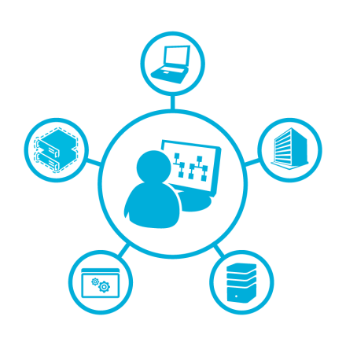

What we are
consulting
software
saas

Slide 7






consulting
bigdata
business intelligence
integration
cloud
azure
mobile
portals
crm

Slide 8
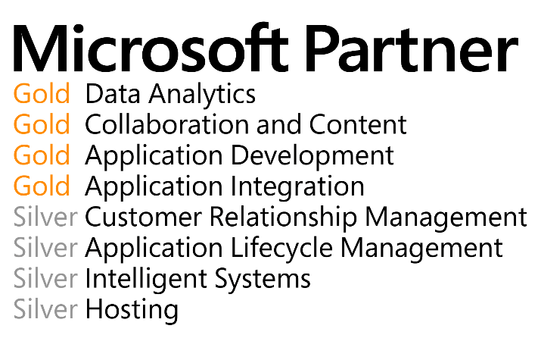





Slide 9































Slide 10






























Slide 11
Agenda

Slide 12
Agenda
ASP.NET Core 2.0 Fundamentals
Deployment Microsoft Azure
In this hands-on lab, you will learn how to:
Create a Web site based on the ASP.NET Core 2.0 template
Build Web UI and Web APIs in the same project
Identify the main components of an ASP.NET Core application
Take advantage of the ASP.NET Scaffolding framework to automatically create Controllers and Views to perform CRUD operations based on your model classes
Expose the same set of information in machine- and human-readable formats using the right tool for each job
Deploy solution to Microsoft Azure

Slide 13
PreRequisites
FREE DreamSpark Azure Account (Students)
Visual Studio Community 2017
A copy (fork/clone) of DevScope repository
Git client (We recommend SourceTree for Windows and MacOSX users)

Slide 14
ASP.NET Core 2.0 Fundamentals

Slide 15
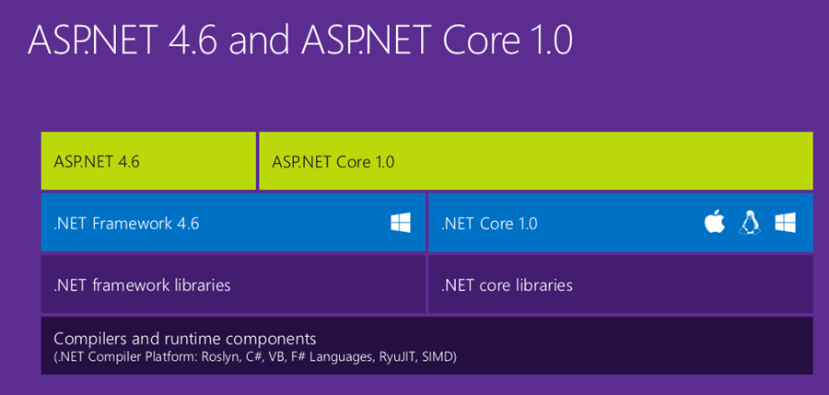

Slide 16
Problems with “Classic” ASP.NET Architecture
Limited hosting capabilities (IIS only)
Dependency on IIS environment (System.Web)
Web evolves faster than the .NET Framework
Requires full .NET Framework
Resource-intensive and not Web/Cloud friendly
Hard to optimize and scale down for lightweight apps
How much server-side processing do you really need?

Slide 17
What is ASP.NET Core?
ASP.NET Core is a complete re-write of ASP.NET
Modular and not platform dependent
The ASP.NET Framework now comes in lots of tiny packages that are brought in through NuGet
Pick and choose the features and components you would like to use
No separate WebAPI, no more WebForms
Cross platform (Windows, Mac, various flavors of Linux, containers)
It’s just a console app
Runs on .NET Framework and .NET Core
How to see if your code can run on .NET Core
.NET Portability Analyzer
ASP.NET Core runs on top of .NET Core (and .NET Framework)
ASP.NET Core 2.0 added a ton of API’s from 1.0

Slide 18
What is ASP.NET Core?
ASP.NET Core is a cross-platform, high-performance, open-source framework for building modern, cloud-based, Internet-connected applications.
Seamless transition from on-premises to cloud
Open-source with contributions
Fast
Cross-platform
Choose your Editors and tools
Faster Development Cycle

Slide 19
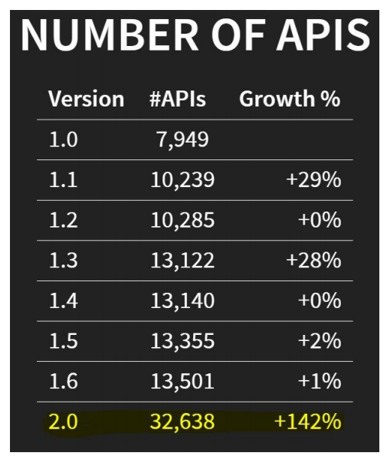

Slide 20
Why use ASP.NET Core?
Millions of developers have used (and continue to use) ASP.NET 4.x to create web apps. ASP.NET Core is a redesign of ASP.NET 4.x, with architectural changes that result in a leaner, more modular framework.
ASP.NET Core provides the following benefits:
A unified story for building web UI and web APIs.
Integration of modern, client-side frameworks and development workflows.
A cloud-ready, environment-based configuration system.
Built-in dependency injection.
A lightweight, high-performance, and modular HTTP request pipeline.
Ability to host on IIS, Nginx, Apache, Docker, or self-host in your own process.
Side-by-side app versioning when targeting .NET Core.
Tooling that simplifies modern web development.
Ability to build and run on Windows, macOS, and Linux.
Open-source and community-focused.

Slide 21
ASP.NET Core Stack
ASP.NET
Web API
MVC
Web Pages
Middleware
.NET CLR
.NET Core CLR
Host
IIS
Self-hosted
OS

Slide 22
Build web APIs and web UI using ASP.NET Core MVC
ASP.NET Core MVC provides features to build web APIs and web apps:
The Model-View-Controller (MVC) pattern helps make your web APIs and web apps testable.
Razor Pages (new in ASP.NET Core 2.0) is a page-based programming model that makes building web UI easier and more productive.
Razor markup provides a productive syntax for Razor Pages and MVC views.
Tag Helpers enable server-side code to participate in creating and rendering HTML elements in Razor files.
Built-in support for multiple data formats and content negotiation lets your web APIs reach a broad range of clients, including browsers and mobile devices.
Model binding automatically maps data from HTTP requests to action method parameters.
Model validation automatically performs client- and server-side validation.

Slide 23
Client-side development
ASP.NET Core integrates seamlessly with popular client-side frameworks and libraries, including Angular, React, and Bootstrap.
Use Gulp
Use Grunt
Manage client-side packages with Bower
Build responsive sites with Bootstrap
Style apps with LESS, Sass, and Font Awesome
Bundle and minify
TypeScript
Use Browser Link
Use JavaScriptServices for SPAs
Use the SPA project templates
Angular project template
React project template
React with Redux project template

Slide 24
ASP.NET Core targeting .NET Framework
ASP.NET Core can target .NET Core or .NET Framework. ASP.NET Core apps targeting .NET Framework aren't cross-platform—they run on Windows only. There are no plans to remove support for targeting .NET Framework in ASP.NET Core. Generally, ASP.NET Core is made up of .NET Standard libraries. Apps written with .NET Standard 2.0 run anywhere that .NET Standard 2.0 is supported.
There are several advantages to targeting .NET Core, and these advantages increase with each release. Some advantages of .NET Core over .NET Framework include:
Cross-platform. Runs on macOS, Linux, and Windows.
Improved performance
Side-by-side versioning
New APIs
Open source
We're working hard to close the API gap from .NET Framework to .NET Core. The Windows Compatibility Pack made thousands of Windows-only APIs available in .NET Core. These APIs weren't available in .NET Core 1.x.

Slide 25
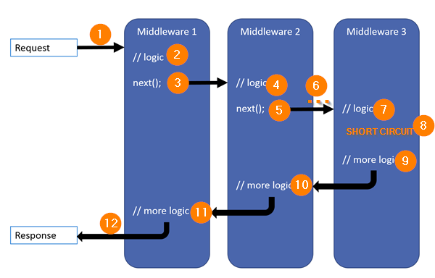
ASP.NET Core – what’s different than ASP.NET 4
ASP.NET Core is simply a console app.
Web Forms is gone
WCF server is gone
Client side package management
web.config is only around for IIS compatibility
Global.asax is gone
Middleware all the things, even MVC
Order matters

Slide 26

Nice New Features over ASP.NET 4
Save and reload, no more building
Dependency Injection built-in
Environments are a first class citizen
TagHelpers > Html Helpers

Slide 27
MVC – Where’s my cheese?
MVC and Web API Controllers have been unified • No more ApiController, just inherit from Controller • Child actions gone in favor of View Components • /Views/_ViewImports.cshtml is your new /Views/web.config • Instead of • Just @using MyNamespace.Something • Static files now served by folder called wwwroot • I treat wwwroot as my “bin” directory. Source files live elsewhere and bundler puts them in wwwroot

Slide 28
MVC – What’s the same?
ASP.NET MVC Concepts are the same • Still have Controllers • Controllers still have Actions • Still have Views • Still have partial views • HTML Helpers still exist • But you should use Tag Helpers

Slide 29
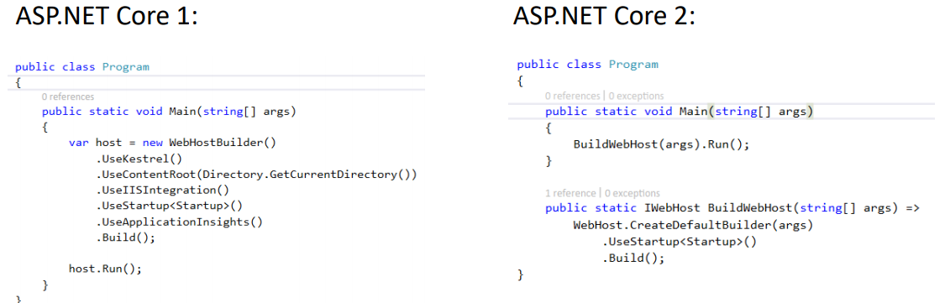
Let’s talk about 2.0
RTM’d on August 14 • A move towards simplicity • More defaults, less verbose • Razor Pages • Configuration and Logging moved up to Program.cs • dotnet CLI changes • Restore implied • New, Customizable Templating Engine • TagHelperComponent • Inject in something (like JS/CSS/etc.) to beginning or end of Head or Body • Precompilation of Views happens on publish by default

Slide 30
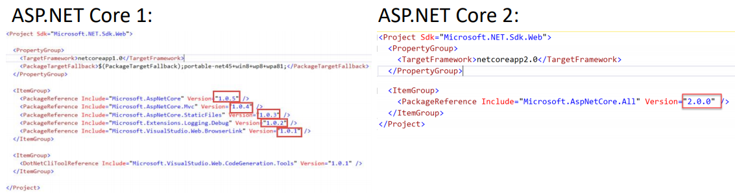
Microsoft.AspNetCore.All Simplifies Dev
Metapackage • Contains ALL the packages Microsoft ships (AspNetCore, EF, etc.) • Simplifies upgrading to latest • Simplifies in “oh I need another NuGet package now” • Publish will “trim” out your packages you don’t need • Utilizes the Runtime Store • More on this later • Publish will also pre-compile views by default • Improve startup time of views • .NET Core 2 feature only (not full framework)

Slide 31
Introducing - Razor Pages
Page focused approach over Controller focused approach • I like this concept a lot. • Focusing on a single page, GET and POST • Dependencies just inject what that page needs • Rarely working on multiple actions/pages at once when working on a bug or feature. Almost always working on a single page.

Slide 32
MVC + Web API + Razor Pages =
ASP.NET Core MVC
Notes:
Runs on all the same MVC infrastructure
Better encapsulation and grouping of UI details
Fewer folders and files

Slide 33
Deployment Microsoft Azure

Slide 34





Azure App Service Family
Web Apps
Web apps that scale with your business
Mobile Apps
Build mobile apps for any device
Logic Apps
Automate business processes across SaaS and on-premises
API Apps
Build and consume APIs in the cloud
Notes:
Azure App Service is a PaaS offering that comprises four separate (but related) services:
Web Apps is a fully managed compute platform optimized to host Web sites and Web applications
Mobile Apps provides infrastructure for hosting back-ends for mobile apps -- for example, it provides infrastructure for sending push notifications not only to Windows clients, but to iOS and Android clients as well
API Apps makes it easy to host APIs in the cloud, features integrated support for Swagger (http://swagger.io/), and offers a built-in authentication service for restricting access to APIs
Logic Apps allows you to automate business processes and workflow -- for example, automatically finding negative tweets about your company and sending notifications to a Slack channel
Together, these services comprise a ready-made solution to many of the challenges involved in publishing Web sites, Web apps, Web services, mobile apps, and more.

Slide 35
Azure Web Apps
Support a variety of languages and platforms
.NET, Java, Node.js, PHP, Python, and more
Support scaling (manual or auto) and load balancing
Support slots for staged deployments and A/B testing
Support continuous integration
Familiar and Fast
Leverage existing skills, plus languages, frameworks, and tools you're familiar with
Enterprise Grade
ISO-, SOC2-, and PCO-compliant with enterprise-level SLAs
Global Scale
Scale up and down as needed, manually or automatically
Notes:
The focus of this presentation is Azure Web Apps (https://azure.microsoft.com/en-us/documentation/articles/app-service-web-overview/). This service supports multiple languages and frameworks, including ASP.NET, Node.js, Java, PHP, and Python, so you can "use what you know" to begin leveraging it quickly. It supports scaling (manually or automatically) so capacity can grow as demand grows. It supports deployment slots for staged deployments -- for example, publish to staging, test your changes there, and then swap it into production only after you're confident it is ready. And it supports continuous integration, enabling you to be agile and aggressive in fixing bugs, adding features, and doing everything else needed to keep your site fresh and up to date.

Slide 36
Scaling - Cloud Computing Patterns
Inactivity
Period
Compute
Compute
t
t
On and Off
Unpredictable Bursts
On & off workloads (e.g. batch job)
Over provisioned capacity is wasted
Time to market can be cumbersome
Unexpected/unplanned peak in demand
Sudden spike impacts performance
Can’t over provision for extreme cases
Compute
Compute
t
t
Growing Fast
Predictable Bursts
Successful services needs to grow/scale
Keeping up w/ growth is big IT challenge
Cannot provision hardware fast enough
Services with micro seasonality trends
Peaks due to periodic increased demand
IT complexity and wasted capacity
Notes:
Deploy a Web app on a single server and you'll hit a wall when the demand on that server reaches a certain level. Deploy it in Azure, however, and you can handle bursts through auto-scaling or steady growth through manual scaling.

Slide 37
Scaling Up vs. Scaling Out
Scale Up
Scale Out
Vary the VM size
Vary the VM count
1 Core w/ 1.75 GB RAM 2 Cores w/ 3.5 GB RAM 4 Cores w/ 7 GB RAM
Max 3* instances Max 10 instances Max 20/50** instances
Notes:
With a traditional server farm, there are two ways to scale to meet demand:
Scale up by beefing up the servers (more RAM, more cores, etc.)
Scale out by adding servers
The same holds true for virtual server farms. In App Services, scale up is a choice between B/S/P 1-3, where 1 = 1 Core, 1/75 GB RAM, 2 = 2 Core, 3.5 GB RAM, 3 = 4 Core, 7 GB RAM. You can also scale up/down between tiers (B/S/P), which impacts local HDD storage (10/50/250 GB) as well as the cap on number of instances (3/10/50).
* For 3 instances on Basic, only manual scaling is supported
** For Premium Tier, there is a max of 20 if not using ASEs, and 50 if using ASE’s

Slide 38
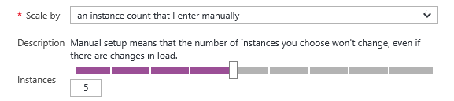
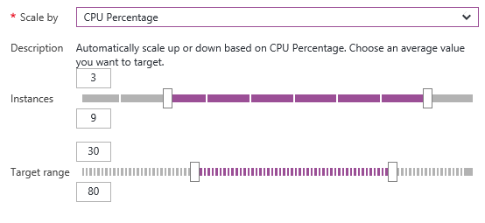
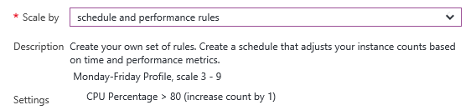
Manual Scaling vs. Auto-Scaling
Manual – Scale via portal or scripts
Auto – CPU Percentage
Auto – Schedule & Performance Rules
Notes:
Manual scaling can be as simple as moving a slider to increase the number of VM instances. Auto-scaling can be enacted by scaling the number of VM instances as CPU utilization increases, or through rules that you specify. An example of the latter is scaling up during certain hours of the day in which you anticipate peak demand.

Slide 39

Web App
Notes:
Demonstrate scaling out in this and the next two slides by showing the VM count increasing as traffic increases.

Slide 40
Web App

Slide 41
Web App

Slide 42
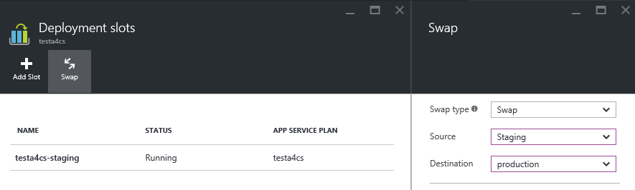
Deployment Slots
Use a Deploy-Confirm-Promote workflow
Promote via “swap” through Azure portal
http://sitename-slotname.azurewebsites.net
Notes:
When you deploy an Azure Web App, you can deploy to a separate deployment slot instead of the default production slot when running in the Standard or Premium App Service plan mode. Deployment slots are actually live web apps with their own hostnames. Web app content and configurations elements can be swapped between two deployment slots, including the production slot. Deploying your application to a deployment slot has the following benefits:
You can validate changes in a staging deployment slot before swapping it with the production slot.
Deploying a web app to a slot first and swapping it into production ensures that all instances of the slot are warmed up before being swapped into production. This eliminates downtime when you deploy your web app. The traffic redirection is seamless, and no requests are dropped as a result of swap operations. This entire workflow can be automated by configuring Auto Swap when pre-swap validation is not needed.
After a swap, the slot with the previously staged web app now has the previous production web app. If the changes swapped into the production slot are not as you expected, you can perform the same swap immediately to get your "last known good site" back
For more information, see https://azure.microsoft.com/en-us/documentation/articles/web-sites-staged-publishing/.

Slide 43
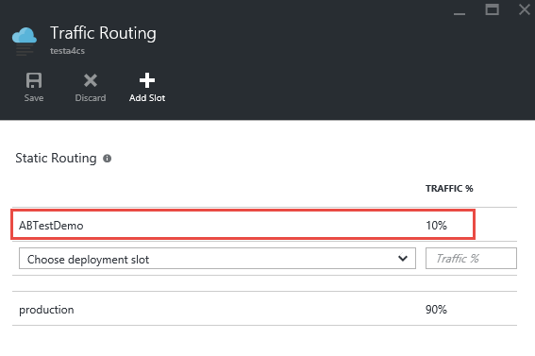
A/B Testing
Test changes by routing requests to different deployment slots
Use Traffic Routing to direct % of traffic to alternate slots
Notes:
A/B testing is useful for determining which of two landing pages, for example, is more effective in engaging customers. With Azure Web Apps, you can easily route traffic to different deployment slots by specifying percentage-based traffic allocations in the portal.

Slide 44






Continuous Integration
Web apps can be deployed manually via FTP or WebDeploy
Automate deployment using 3rd party source-control providers
Can also use a local Git repository from Azure Portal
Git
Visual Studio Team Services
CodePlex
GitHub
BitBucket
DropBox
Notes:
Continuous integration means deploying updates to your Web app as often as needed -- even several times a day. Azure supports many different deployment methods, including FTP, Git deployment (publishing from a local Git repository to Azure), and WebDeploy, which supports diff-deployment, database creation, and more. Visual Studio has integrated support for all three. Teams can also publish via third-party source-control providers such as Kudu (https://github.com/projectkudu/kudu/wiki/Deployment), which supports deployments from OneDrive and Dropbox, as well as repository-based deployments from GitHub, BitBucket, VSTS, and local Git repositories. For more information, see https://azure.microsoft.com/en-us/documentation/articles/web-sites-deploy/.

Slide 45


Continuous Integration + Deployment Slots
Production
5
Developer commits code
Automated process builds/compiles and deploys to staging slot
Automated and other tests validate content in staging slot
Staging content promoted to production
Users see updated site
1
4
2
3
Source Control
Staging
Test
Notes:
This process is a tried and tested one that is easily enacted using a combination of Azure features (e.g., deployment slots) and tooling support (e.g., Visual Studio).

Slide 46
App Service Plans
Billing and provisioning for App Service resources
 | Free | Shared | Basic | Standard | Premium
# of Apps | 10 | 100 | Unlimited | Unlimited | Unlimited
Shared Disk Space | 1 GB | 1 GB | 10 GB | 50 GB | 500 GB
Maximum Instances | 1 | 1 | 3 | 10 | 50
Autoscale | No | No | No | Yes | Yes
Staging Environments |  |  |  | 5 | 20
Custom Domains | No | Yes | Yes | Yes | Yes
SLA |  |  | 99.95%
Notes:
When you create an Azure Web App, you are asked to choose an App Service plan (or create a new one). These plans support 5 pricing tiers (Free, Shared, Basic, Standard, and Premium), with each tier offering a unique combination of capabilities and capacity. Apps in the same subscription and geographic location can share a plan. For more information, see https://azure.microsoft.com/en-us/documentation/articles/azure-web-sites-web-hosting-plans-in-depth-overview/.

Slide 47
Hands-on Lab

Slide 48
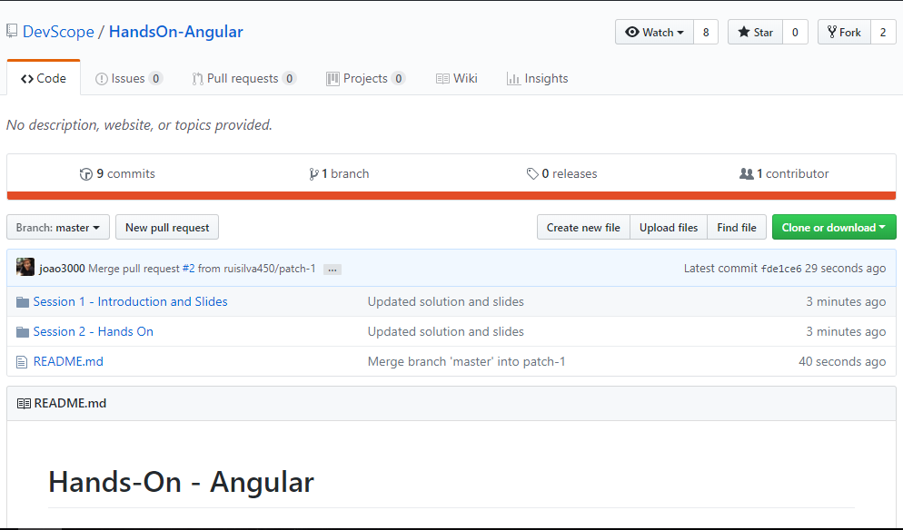
Hands-on Labs
https://github.com/DevScope/HandsOn-ASPNETCore

Slide 49
Rua Passos Manuel Nº 223 – 4º Andar
4000-385 Porto
T. +351 223 751 350/51
F. +351 223 751 352
info@devscope.net
www.devscope.net

Slide 50
Create Web App on Azure

Slide 51
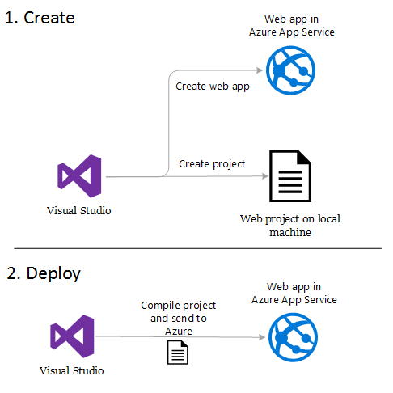
Create Web App on Azure
.NET
Java
PHP
Python
HTML/JS/CSS
etc

Slide 52
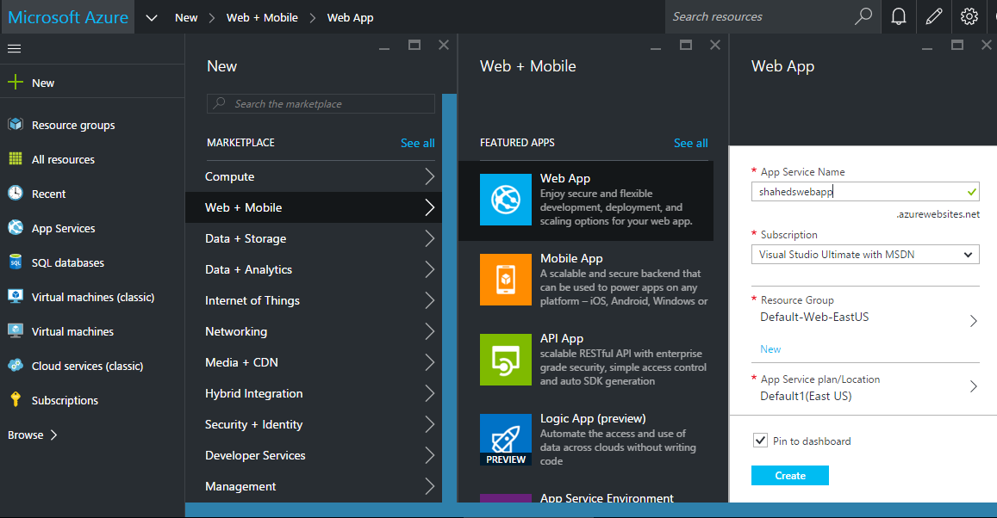
Create Web App on Azure

Slide 53
Deploy Web Apps to Azure
Using the publish profile in Visual Studio 2017

Slide 54
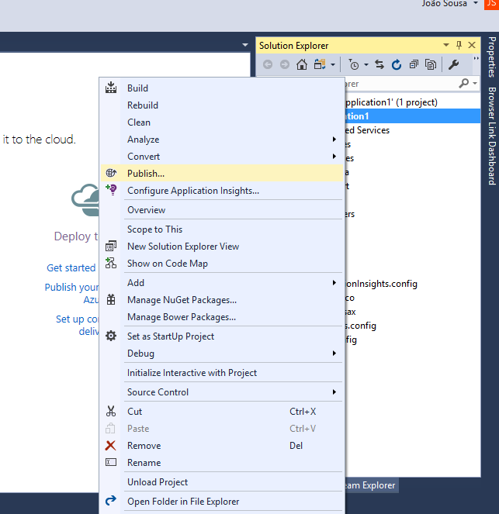
Using the publish profile in Visual Studio 2017

Slide 55
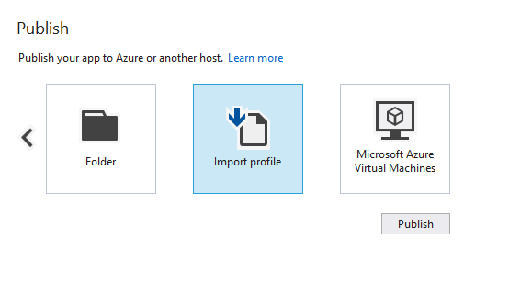
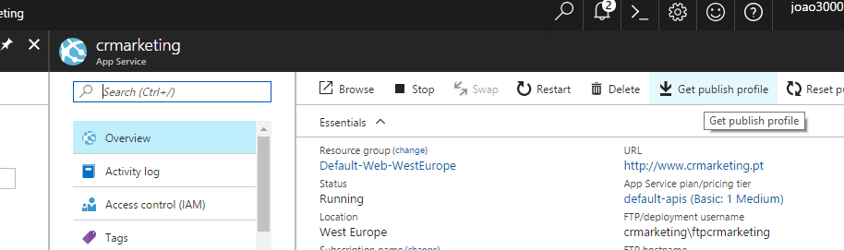
Using the publish profile in Visual Studio 2017

Slide 56
Using the publish profile in Visual Studio 2017

Slide 57
Deploy Web Apps to Azure
Using some FTP client (like FileZilla)

Slide 58
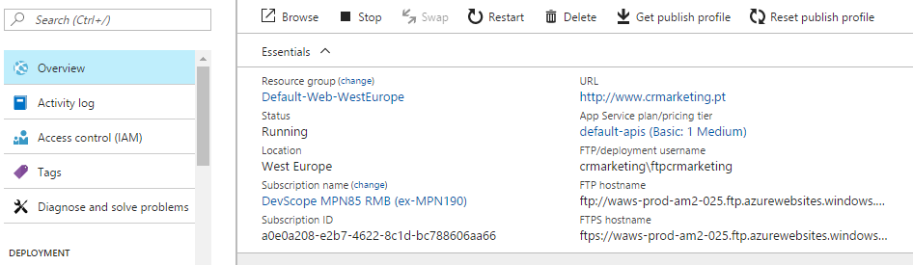
Using some FTP client
If you are used to manually copying your web content to a web server, you can use an FTP utility to copy files, such as Windows Explorer or FileZilla.
How to upload files with FTP
The Azure Portal gives you all the information you need to connect to your app's directories using FTP or FTPS.

Slide 59
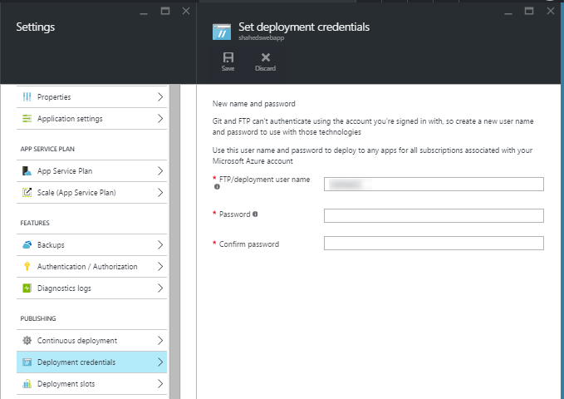
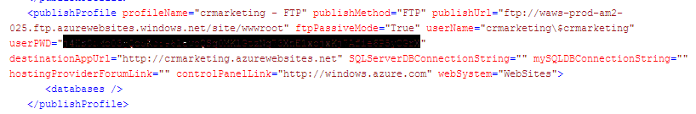
Using some FTP client

Slide 60
Deploy Web Apps to Azure
Using the Continuous Integration and GitHub

Slide 61
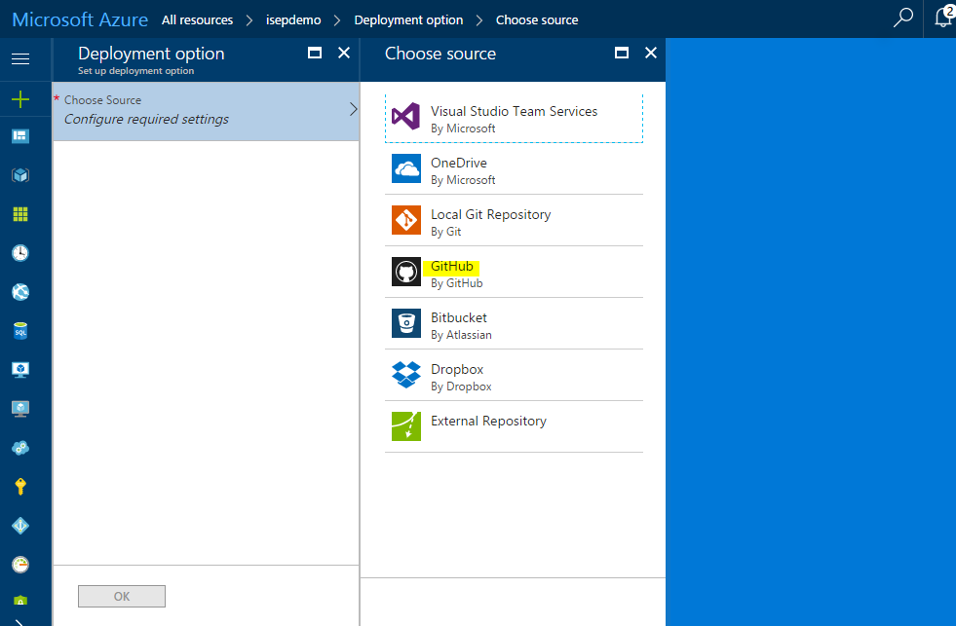
Using the Continuous Integration and GitHub

Slide 62
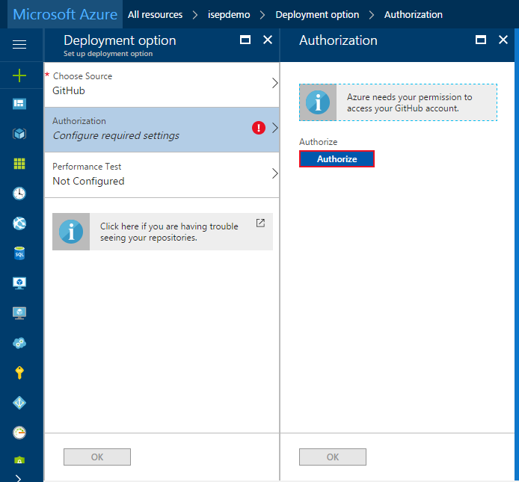
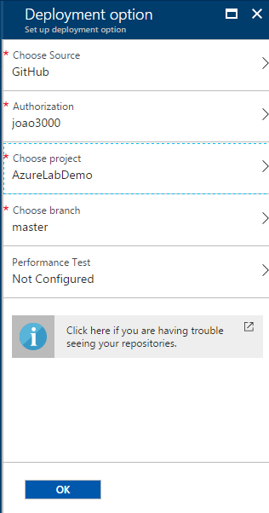
Using the Continuous Integration and GitHub

